Slide 1
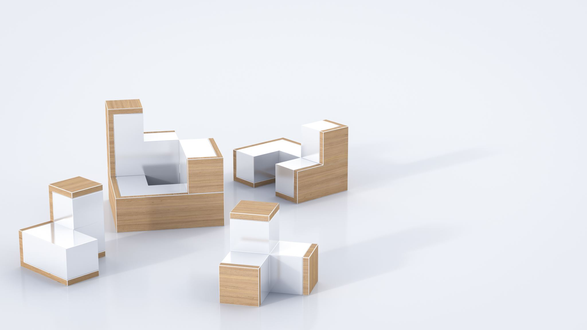
Furniture Store App
Developed using Flutter

Slide 2
Introduction
The Furniture Store App is a project developed using Flutter to provide a seamless shopping experience for furniture enthusiasts. It allows users to browse, add items to the cart, and place orders effortlessly.

Slide 3
Features
- User-friendly interface
- Add to Cart functionality
- Checkout process
- Signup/Login system
- Order tracking and management

Slide 4
Screens Overview
1. Home Screen: Displays available furniture.
2. Cart Screen: Allows users to view and manage their cart.
3. Orders Screen: Displays user's past orders.
4. Signup/Login Screen: User authentication system.

Slide 5
Technology used
Flutter for UI development
Dart programming language
FireBase for Authentication.

Slide 6
Challenges Faced
- Designing a responsive UI for multiple devices
- Implementing a seamless checkout process
- Managing state efficiently using Flutter

Slide 7
Conclusion
The Furniture Store App demonstrates the capabilities of Flutter in building efficient and user-friendly e-commerce applications. It highlights the importance of design, functionality, and seamless user experience.

